Slide 1
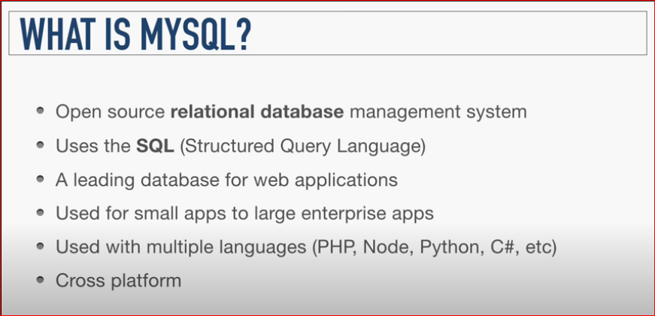

Slide 2
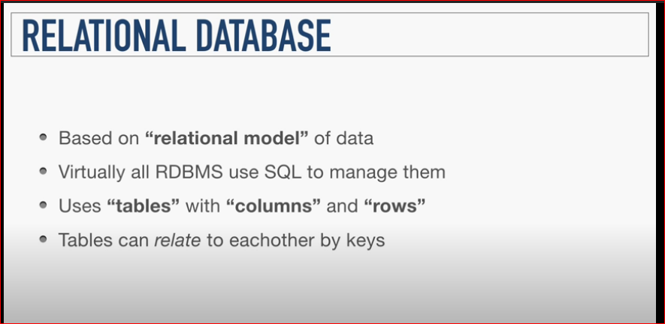

Slide 3
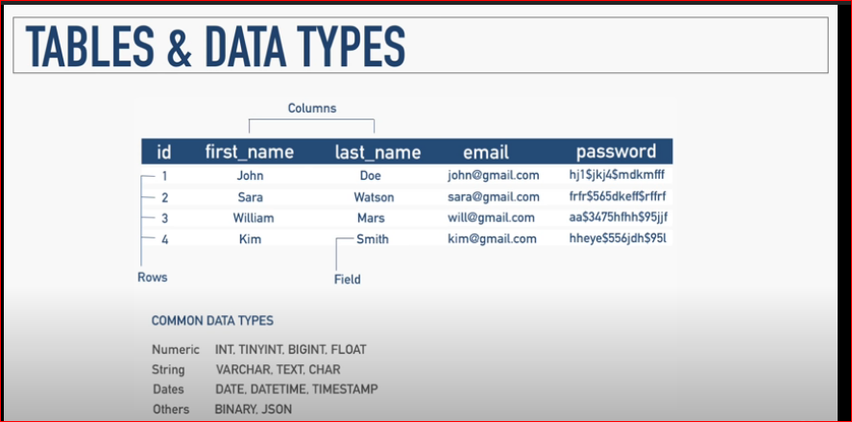

Slide 4
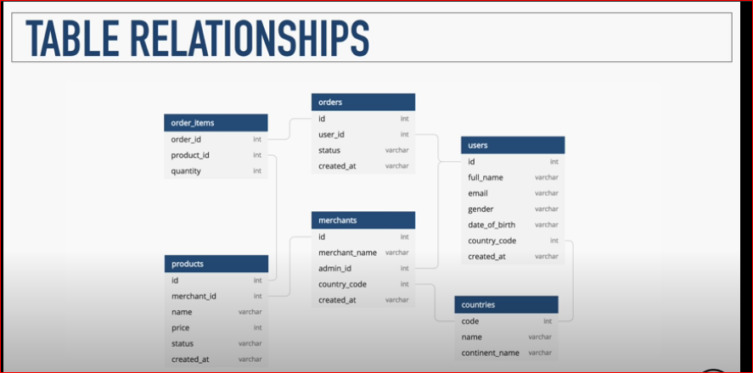

Slide 5
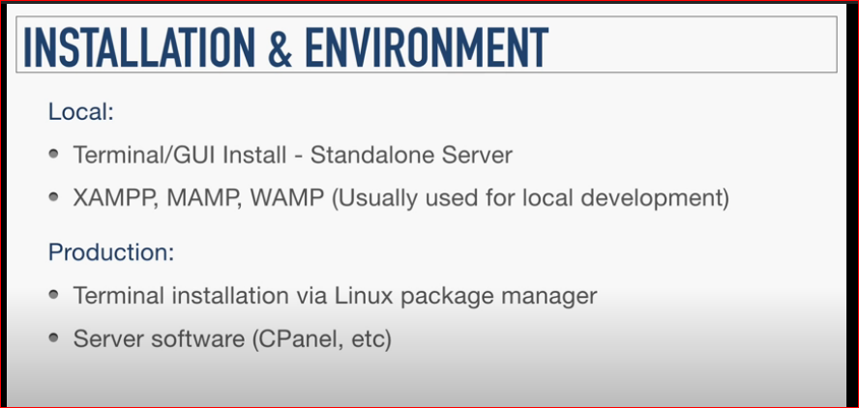

Slide 6
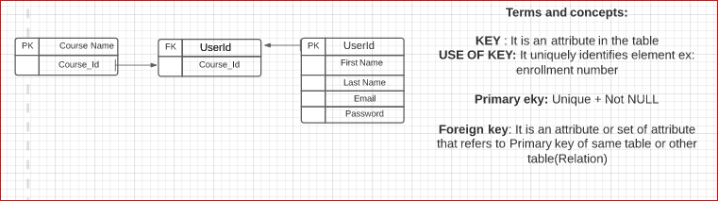

Slide 7
Cheatsheet:
https://gist.github.com/Shubhamdutta2000/cde46739cad4618ff67cc59c7d669074

